Slide 1


2nd day
Question & Answer
Since when did this start on our campus?
Use of Microcontroller ?
Embedded Systems Engineering career guidelines ?
Industry collaboration and opportunity form Alpha Science LAB?
Why is our in-house developed microcontroller a more cost-effective long-term solution for high-volume projects?
Can we using AI in Development ?
Can we use in computer and laptop ?
GPIO ?
Firmware details?
RISV-V
Hadi-V
SWADHEEN Microcontroller ?

Slide 2
Fundamentals of C++ for Hardware
Why use C++ why not C?
What is variable ?Memory As storage box!
What is data type and Data type in C++?
Best practice of Const keyword!
Operator?
Arithmetic operator & Integer Division ?
Logical Operator ?
Decision making if else and switch case
Different between switch case
Use of volatile key word
All Type of Loop

Slide 3
Function ?
Call by value and call by reference ?
Function prologue &Function epilogue
Array?
String
Pointer
Real life example of pointer
Arduino Code vs SWADHEEN

Slide 4
Why use C++ why not C?
⚡ Zero-Cost Abstractions
🛡️ Type Safety & Encapsulation
🔧 Flexible Hardware Drivers

Slide 5
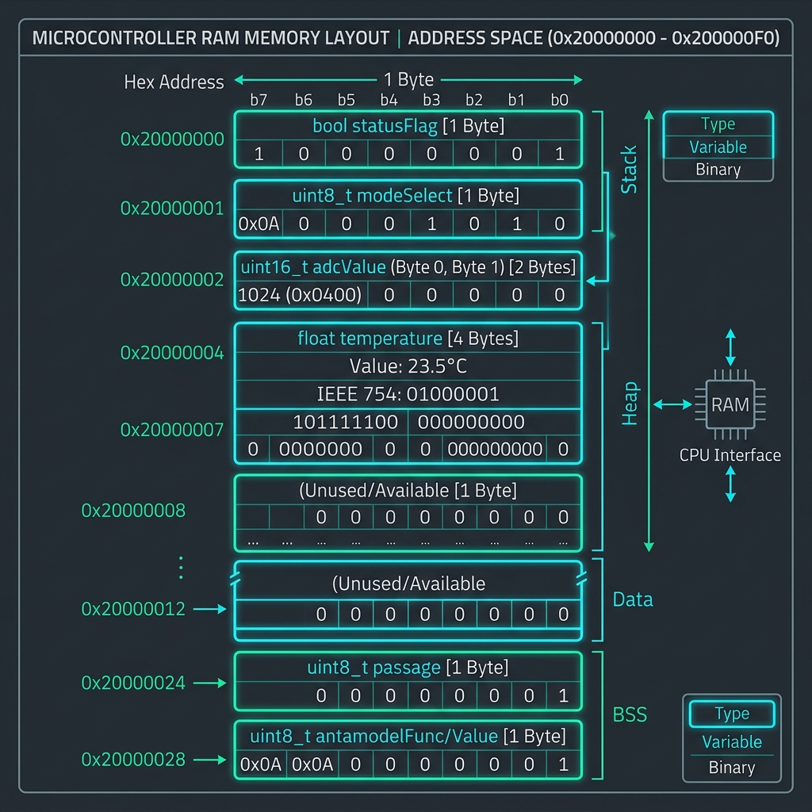
What is variable ? Memory As storage box!
// RAM Storage & Variable Mechanics
// Variable Declaration in RAM Memory
bool statusFlag = true; // 1 Byte RAM (0x20000000)
uint16_t adcValue = 1024; // 2 Bytes RAM (0x20000002)
float temperature = 23.5; // 4 Bytes RAM (0x20000004)
// Variable Mutation & RAM Update
adcValue = 2048; // Updates RAM bits directly
statusFlag = false; // Toggles bit 0 in memory
// Best Practice for Microcontrollers
const int PIN = 5; // Read-only (Stored in Flash ROM)

Slide 6
What is data type and Data type in C++?
📊 C++ Data Types & Microcontroller Memory Footprint Matrix
Data types inform the compiler how many bytes of RAM to reserve and how to interpret raw binary bits (Signed vs Unsigned, Fixed-Point vs Floating Point).
Data Type | RAM Size | Value Range / Bit Representation | Embedded Hardware Application
bool | 1 Byte (8 bits) | true (1) or false (0) | Digital GPIO Pin State (HIGH/LOW)
char / uint8_t | 1 Byte (8 bits) | 0 to 255 (Unsigned ASCII) | UART Serial RX/TX Byte & 8-bit Registers
int / int16_t | 2 Bytes (16 bits) | -32,768 to 32,767 | Standard 10-bit & 12-bit ADC Readings
uint32_t | 4 Bytes (32 bits) | 0 to 4,294,967,295 | 32-bit Hardware MMIO Register Addresses
float | 4 Bytes (32 bits) | IEEE 754 Single Precision | Sensor Calibration & Physics Calculations
double | 8 Bytes (64 bits) | IEEE 754 Double Precision | ⚠️ Avoid on 32-bit Cores without FPU

Slide 7
Best practice of Const keyword
WITHOUT 'const' (Dangerous & RAM Heavy)
✅ WITH 'const' / 'constexpr' (Safe & Flash ROM)
// Plain Mutable Variable
int LED_PIN = 13; // Uses precious RAM!
void setup() {
pinMode(LED_PIN, OUTPUT);
}
void loop() {
LED_PIN = 99; // DANGER! Accidental change
digitalWrite(LED_PIN, HIGH); // Crashes Pin!
}
// Read-Only Constant in Flash ROM
const int LED_PIN = 13; // Flash stored!
void setup() {
pinMode(LED_PIN, OUTPUT);
}
void loop() {
// LED_PIN = 99; -> COMPILE ERROR!
// Compiler blocks accidental modification.
digitalWrite(LED_PIN, HIGH); // Safe!
}

Slide 8
Operator?
➕ Arithmetic Operators
📝 Assignment & Compound
• + Addition: val = a + b;
• - Subtraction: val = a - b;
• * Multiplication: val = a * b;
• / Division: val = a / b;
• % Modulo Remainder: val = a % b;
• = Direct Assign: x = 10;
• += Add & Assign: x += 5; // x = x + 5
• -= Sub & Assign: x -= 2; // x = x - 2
• &= Bitwise AND: REG &= ~(1<<3);
• |= Bitwise OR: REG |= (1<<3);
🔍 Relational Operators
⚡ Bitwise Operators (Hardware Core)
• == Equal to: if (x == 10)
• != Not Equal: if (x != 0)
• > Greater than: if (temp > 30)
• < Less than: if (val < 100)
• >= / <=: Threshold comparison
• & Bitwise AND: Masking specific bits
• | Bitwise OR: Setting register bits
• ^ Bitwise XOR: Toggling register bits
• ~ Bitwise NOT: Inverting all bits
• << / >> Shift: Shifting pin positions

Slide 9
Arithmetic operator & Integer Division ?
Integer Truncation Hazard Alert!
In C++, dividing two integer variables performs INTEGER DIVISION. The fractional remainder is truncated toward zero, causing unexpected zero results in sensor equations!
5 / 2
= 2
Fraction .5 is completely dropped!
1 / 2
= 0
CRITICAL: ADC scale drops to zero!
5 % 2
= 1
Modulo captures integer remainder 1.
Solutions for Precision
1. Explicit Type Casting: float result = (float)5 / 2; // 2.5
2. Floating Point Literal: float result = 5.0 / 2; // 2.5
3. Fixed-Point Scaling: uint32_t milliVolts = (adcVal * 3300) / 1024; // Preserves precision without float

Slide 10
Arithmetic operator & Integer Division ?
Modulo Arithmetic & Fixed-Point vs Floating-Point Comparison Table
In resource-constrained 32-bit microcontrollers, scaling numbers up into Fixed-Point Integers completely eliminates soft-float library overhead.
Math Approach | C++ Code Example | Execution Speed | Flash & RAM Impact | Hardware Suitability
Soft Floating Point | float v = (adc * 3.3) / 1024.0; | Slow (~80 CPU cycles) | Pulls +2.5 KB Soft-Float Library | NO FPU 32-bit Cores
Fixed-Point Integer | uint32_t mV = (adc * 3300) / 1024; | Blazing Fast (1 ALU cycle) | 0 Bytes Extra Library Overhead | Ideal for RISC-V / SWADHEEN
Modulo Wrapping (%) | index = (index + 1) % 8; | Fast (Integer Modulo) | Zero Memory Overhead | Circular Ring Buffers
Periodic Timer (%) | if (ticks % 100 == 0) toggle(); | Fast (Branch on zero) | Zero Memory Overhead | LED & Sensor Polling Timers

Slide 11
Logical Operator ?
&& Logical AND
|| Logical OR
! Logical NOT
• true && true: true
• true && false: false
• false && false: false
• Rule: BOTH conditions MUST be true.
• Hardware Code: if (temp > 30 && fanOn)
• true || true: true
• true || false: true
• false || false: false
• Rule: At least ONE condition is true.
• Hardware Code: if (btn1 == LOW || btn2 == LOW)
• !true: false
• !false: true
• Rule: Inverts boolean truth state.
• Hardware Code: if (!sensorReady)

Slide 12
Decision making if else and switch case
🔀 if / else if / else (Range Logic)
🎛️ switch / case (Discrete State Machine)
int temp = 28;
if (temp < 0) {
setHeater(HIGH);
}
else if (temp >= 0 && temp < 25) {
setHeater(LOW);
}
else {
setCooler(HIGH);
}
// Ternary Operator (Compact if-else)
String state = (temp > 25) ? "HOT" : "OK";
int mode = 2;
switch (mode) {
case 1:
digitalWrite(LED1, HIGH);
break; // Prevent fallthrough!
case 2:
digitalWrite(LED2, HIGH);
break;
default:
allLedsOff();
}

Slide 13
Different between switch case
Feature / Criteria | if-else Structure | switch-case Structure | Hardware & Performance Impact
Condition Evaluation | Evaluates complex boolean ranges & floating points. | Evaluates discrete integer constants & enums only. | if-else is versatile; switch is constrained.
Compiler Optimization | Sequential branch testing (beq/bne instructions). | Optimizes into direct CPU Jump Table (jr offset). | Jump tables jump instantly to target address.
Execution Speed | O(N) sequential check (slower for many cases). | O(1) constant lookup time via jump table. | switch is significantly faster for 4+ cases.
Fallthrough Behavior | Branches are isolated independently. | Requires explicit 'break;' to prevent fallthrough. | Accidental fallthrough is a common bug!
Embedded Use Case | Sensor thresholding, floating point logic. | Finite State Machines (FSM), UART menus. | Use switch for clean state machine code.

Slide 14
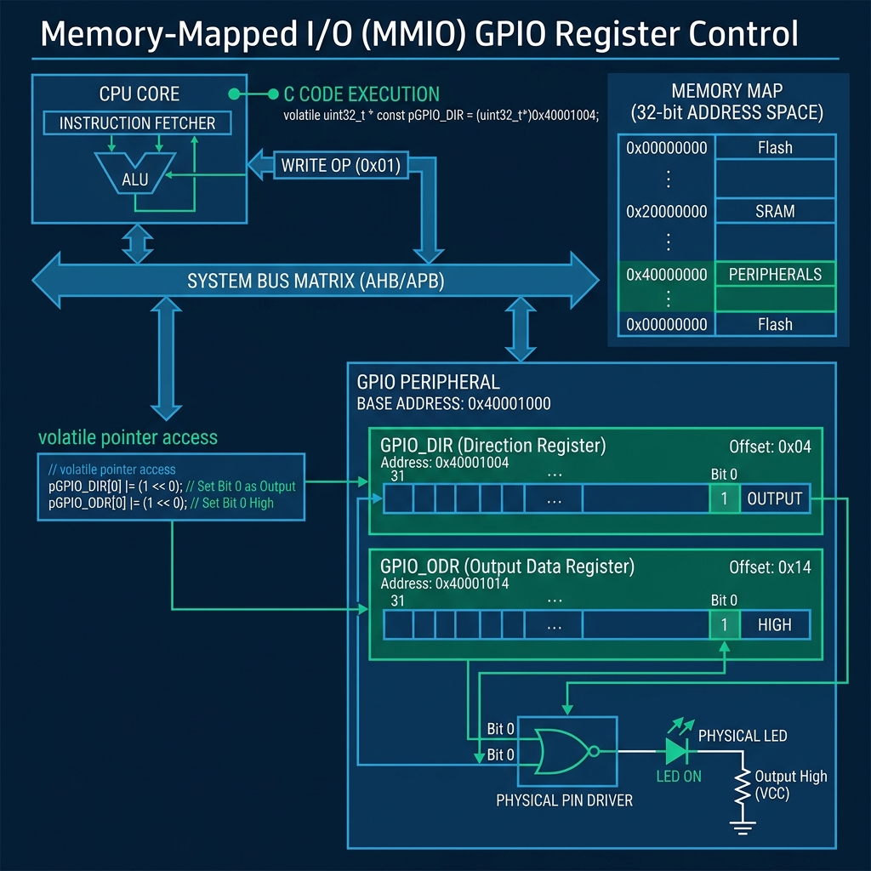
Use of volatile key word
// Volatile Hardware Polling Code
// WITHOUT 'volatile': Compiler caches value!
int status = 0; // Bugs out in ISR polling!
// WITH 'volatile': Forces direct RAM/MMIO read!
volatile int hwStatus = 0;
void ISR_handler() {
hwStatus = 1; // Hardware ISR updates RAM
}
void main() {
while (hwStatus == 0) {
// Re-reads memory address on EVERY cycle!
}
}

Slide 15
Loop
⚡ Embedded Superloop Pattern
Microcontrollers run without an Operating System exit. They utilize an infinite 'Superloop' (while(1) or loop()) to continuously sample sensors, process logic, and update outputs.
🔁 for Loop
🔄 while Loop
🔂 do-while Loop
Counter-Based Iteration
Used for fixed iterations e.g. multi-sample ADC averaging or PWM sweeping.
Condition-Based Polling
Used for hardware busy polling or infinite main superloops.
Guaranteed 1st Execution
Used for sensor init handshakes where execution must run at least once.

Slide 16
For loop
🔍 For Loop Anatomy & Syntax
💡 Hardware Example: PWM LED Fading
// for (init; condition; increment)
for (int i = 0; i < 5; i++) {
// Loop body runs 5 times
}
// Execution Order:
// 1. int i = 0 (Init: Runs ONCE)
// 2. i < 5 (Condition check)
// 3. Execute Body
// 4. i++ (Increment step)
// 5. Repeat steps 2-4 until false
const int LED_PIN = 9;
void setup() {
pinMode(LED_PIN, OUTPUT);
}
void loop() {
// Fade LED in from 0 to 255 PWM
for (int duty = 0; duty <= 255; duty++) {
analogWrite(LED_PIN, duty);
delay(10); // 10ms step delay
}
}

Slide 17
While loop
⏳ Hardware Busy Polling
⚡ Bare-Metal Main Superloop
// Poll ADC until conversion is ready
while (adcBusyFlag == true) {
// Wait for hardware flag
}
// Poll UART buffer until byte arrives
while (Serial.available() == 0) {
// Wait for incoming RX byte
}
char data = Serial.read();
int main() {
hardwareInit();
// Infinite Firmware Superloop
while (true) {
readSensors();
processControlLogic();
updateOutputs();
}
return 0;
}

Slide 18
Do while Loop
🔂 Post-Condition Loop Structure
📡 Sensor Initialization Retry
do {
// 1. Execute body FIRST
// (Guaranteed at least 1 run!)
}
while (condition); // 2. Check condition
// Key Difference from while():
// while() checks condition BEFORE body.
// do-while checks condition AFTER body.
int retries = 0;
bool ack = false;
do {
ack = sendSensorPing();
retries++;
delay(50);
}
while (!ack && retries < 5);
if (ack) Serial.println("Sensor Ready!");

Slide 19
Function
🧱 Function Structure & Syntax
⚡ Firmware Architectural Benefits
// return_type name(param_list)
int calculatePWM(int temperature) {
if (temperature > 40) {
return 255; // Max fan speed
}
return (temperature * 255) / 40;
}
void setup() {
int pwm = calculatePWM(30);
}
1. Code Modularity:
Isolates complex peripheral register code into clean API blocks.
2. Flash ROM Reuse:
Saves Flash memory by re-using one machine instruction block.
3. RAM Stack Scoping:
Local variables exist only during function execution, freeing RAM upon return.

Slide 20
Call By Value And call By reference
📦 Call by Value (Creates Temporary Copy)
🔗 Call by Reference (&) (Direct Address Access)
void resetCounter(int count) {
count = 0; // Modifies LOCAL copy!
}
void main() {
int myCount = 50;
resetCounter(myCount);
// myCount is STILL 50!
// Creates stack copy overhead.
}
void resetCounter(int &count) {
count = 0; // Modifies ORIGINAL!
}
void main() {
int myCount = 50;
resetCounter(myCount);
// myCount is now 0!
// Zero memory copy overhead.
}

Slide 21
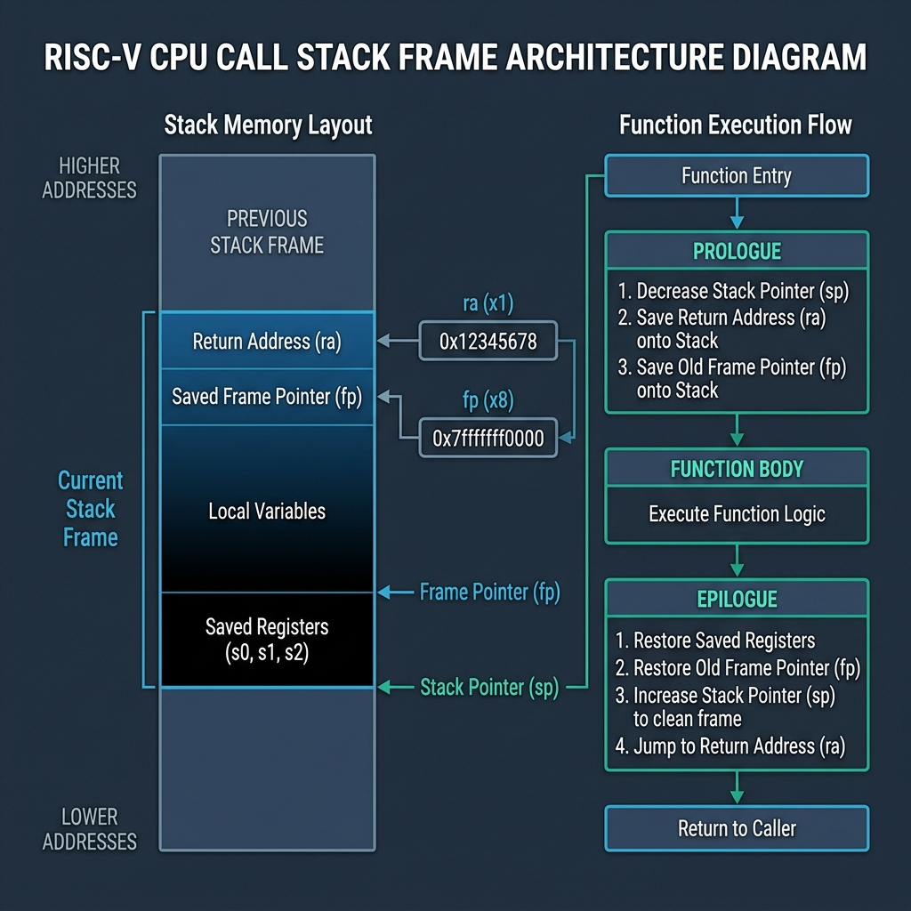
Function prologue &Function epilogue
// RISC-V Assembly Stack Mechanics
// 1. PROLOGUE (Function Entry)
addi sp, sp, -16 # Allocate 16-byte stack frame
sw ra, 12(sp) # Save Return Address
sw s0, 8(sp) # Save Frame Pointer
// 2. FUNCTION BODY
// Executes compiled C++ instructions...
// 3. EPILOGUE (Function Exit)
lw ra, 12(sp) # Restore Return Address
lw s0, 8(sp) # Restore Frame Pointer
addi sp, sp, 16 # Pop stack frame
ret # Jump to ra register

Slide 22
Array?
💾 Contiguous RAM Array Layout
// Declaring Fixed Size RAM Array
uint16_t adcSamples[4] = {102, 305, 450, 512};
// Accessing Elements (Zero-Indexed)
uint16_t s0 = adcSamples[0]; // 102
uint16_t s3 = adcSamples[3]; // 512
// Total Size in RAM
size_t totalBytes = sizeof(adcSamples); // 8 Bytes
size_t count = sizeof(adcSamples) / sizeof(adcSamples[0]);
adcSamples[0] = 102 | 0x20000000
adcSamples[1] = 305 | 0x20000002
adcSamples[2] = 450 | 0x20000004
adcSamples[3] = 512 | 0x20000006

Slide 23
Traversing Array
🔁 Index Subscript Traversal (arr[i])
⚡ Pointer Arithmetic Traversal (*(arr+i))
uint16_t samples[5] = {10, 20, 30, 40, 50};
uint32_t sum = 0;
for (int i = 0; i < 5; i++) {
sum += samples[i]; // Access by index
}
uint16_t average = sum / 5; // 30
uint16_t samples[5] = {10, 20, 30, 40, 50};
uint16_t* ptr = samples; // Points to samples[0]
uint32_t sum = 0;
for (int i = 0; i < 5; i++) {
sum += *ptr; // Dereference pointer
ptr++; // Advance 2 Bytes in RAM
}

Slide 24
String
✅ C-Style Null-Terminated char[] (Recommended)
⚠️ Arduino String Class Warning
// Fixed RAM/Flash allocation
char msg[] = "SWADHEEN"; // 9 Bytes with \0
void setup() {
Serial.println(msg);
}
// Zero heap fragmentation!
// Fast & lightweight for UART.
// Dynamic Heap Allocation
String data = "Temperature: ";
data += 36.5; // Allocates & reallocates heap!
// DANGER on Microcontrollers:
// Causes severe RAM fragmentation,
// leading to sudden random crashes!

Slide 25
Pointer
📌 Pointer & Address Visualizer
⚡ Hardware MMIO Register Pointers
int targetVar = 100; // Stored at 0x20000010
int* pTarget = &targetVar;
// pTarget holds address: 0x20000010
// *pTarget dereferences value: 100
*pTarget = 200; // Mutates targetVar to 200!
// Mapping pointer directly to physical MMIO address
#define GPIO_DATA_ADDR 0x40001000
volatile uint32_t* pGpioData =
(volatile uint32_t*)GPIO_DATA_ADDR;
// Write directly to chip pin hardware register!
*pGpioData = 0xFF; // Set pins HIGH

Slide 26
Real project And real life example
// SWADHEEN Bare-Metal GPIO Project
// SWADHEEN GPIO Base Register
#define GPIO_BASE 0x40001000
#define GPIO_DIR (*(volatile uint32_t*)(GPIO_BASE + 0x00))
#define GPIO_DATA (*(volatile uint32_t*)(GPIO_BASE + 0x04))
int main() {
GPIO_DIR |= (1 << 5); // Pin 5 Output
while(1) {
GPIO_DATA |= (1 << 5); // HIGH
GPIO_DATA &= ~(1 << 5); // LOW
}
}

Slide 27
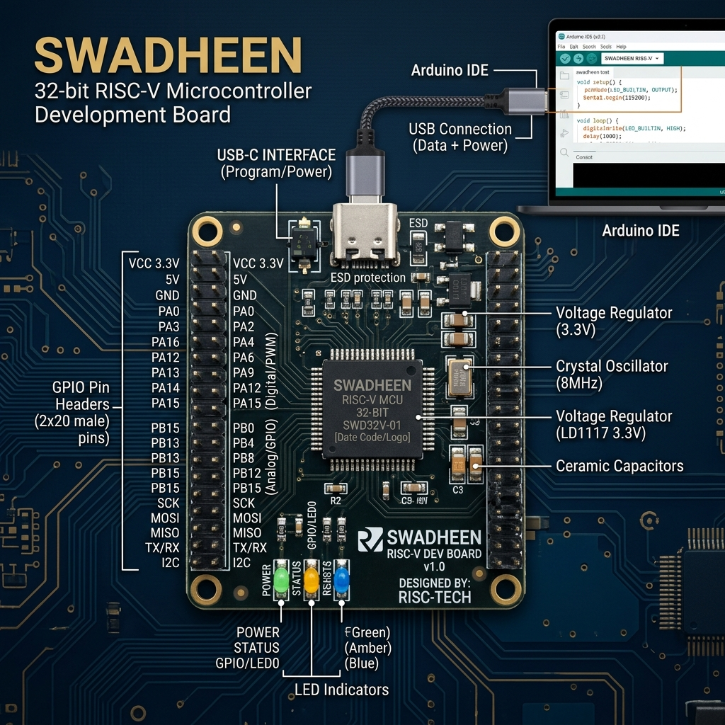
Arduino IDEA setup
🛠️ Arduino IDE Setup Workflow
Step 1: Board Manager URL:
Preferences -> Additional Board Manager URLs -> Add SWADHEEN RISC-V Core JSON link.
Step 2: Install Toolchain:
Tools -> Board Manager -> Search 'SWADHEEN 32-Bit RISC-V' & Click Install.
Step 3: Flashing Firmware:
Select Board: 'SWADHEEN v1.0', Select COM Port, and Click Upload (Ctrl+U).

Slide 28
Light on of code for arduino
⚡ High-Level Arduino HAL Blink Code
🔍 Arduino HAL Layer Analysis
const int LED_PIN = 13;
void setup() {
// Configure pin mode via HAL API
pinMode(LED_PIN, OUTPUT);
}
void loop() {
digitalWrite(LED_PIN, HIGH); // Turn LED ON
delay(1000); // Wait 1 second
digitalWrite(LED_PIN, LOW); // Turn LED OFF
delay(1000); // Wait 1 second
}
• High Abstraction Level:
Easy for beginners, hides underlying register hardware completely.
• Hidden Call Overhead:
digitalWrite() performs pin lookup tables, safety checks, and bit shifting on EVERY call!
• Slower Toggle Speed:
Max pin toggling speed restricted to ~100-200 kHz due to HAL function call overhead.

Slide 29
Light on of BY SWADHEEN
⚡ SWADHEEN Bare-Metal C++ Execution vs Arduino HAL Benchmark Table
Direct RISC-V MMIO register access yields 80x faster pin toggling speed and saves over 4KB of Flash ROM memory space.
Benchmark Metric | Arduino HAL Implementation | SWADHEEN Bare-Metal C++ | Performance Advantage
Compiled Binary Flash | ~4.8 KB Flash | ~0.4 KB Flash | 12x Smaller Flash Footprint
Pin Toggle Frequency | ~150 kHz Max Speed | ~12.5 MHz Max Speed | 80x Faster Execution Speed
RAM Memory Usage | ~180 Bytes RAM | 0 Bytes RAM Overhead | Zero RAM Consumption
Register Control | Abstracted HAL lookup | Direct MMIO Pointer Access | Real-Time Predictable Latency

Slide 30
Continue for next day
🎉 Day 2 Mastery Summary & Day 3 Advanced Hardware Roadmap
Congratulations on mastering fundamental C++ hardware principles! Below is the summary of achievements and preview of tomorrow's session.
Category | Day 2 Completed Topics | Day 3 Next Day Roadmap
Memory & Variables | RAM Storage Boxes, Data Type Matrix, Const Flash ROM | Dynamic Memory Management & Custom Heap Drivers
Control & Loops | Switch Jump Tables, Volatile Keyword, Superloop | Hardware Interrupt Service Routines (ISRs)
Functions & Stack | Call by Value/Ref, RISC-V Prologue & Epilogue Stack Frames | FreeRTOS Task Scheduling & Real-Time Kernel
Peripheral Control | Pointers, MMIO Registers, SWADHEEN Bare-Metal Blink | PWM Timers, UART Serial, SPI/I2C Sensor Bus

Slide 31
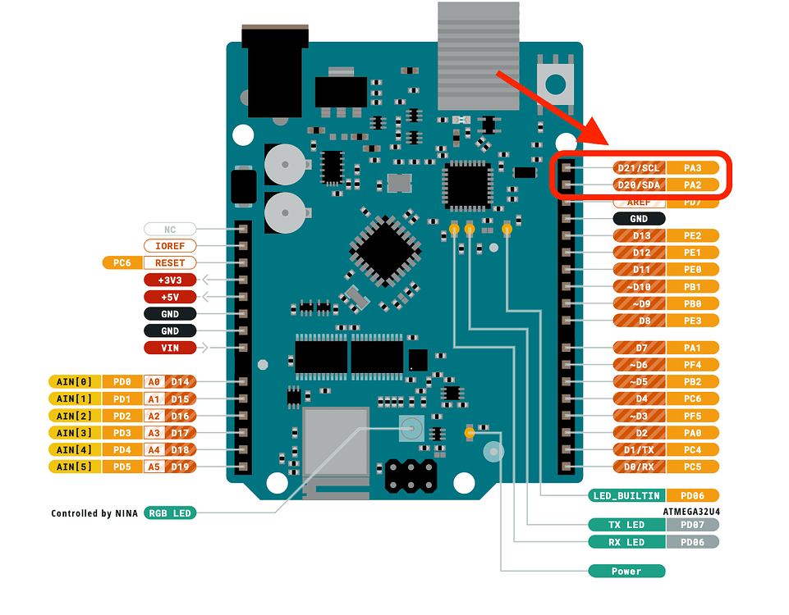
Continue for next day

